Slide 1
Digital Portfolio
STUDENT NAME: C.H.Ahmed Basha
REGISTER NO AND NMID: 31924U09002
DEPARTMENT: B.C.A
COLLEGE: MAZHARUL ULOOM COLLEGE(AUTONOMOUS)

Slide 2
PROJECT TITLE
PERSONAL DIGITAL PORTFOLIO

Slide 3


AGENDA
Problem Statement
Project Overview
End Users
Tools and Technologies
Portfolio design and Layout
Features and Functionality
Results and Screenshots
Conclusion
Github Link
3/21/2024 Annual Review

Slide 4

PROBLEM STATEMENT
In today's digital world, students and professionals need a platform to showcase their skills, projects, and achievements. Atraditional resume is not interactive and fails to demonstrate practical skills effectively.

Slide 5

PROJECT OVERVIEW
This project focuses on creating a Digital Portfolio Website that highlights personal information, skills, projects, and achievements in an interactive and user-friendly format. It serves as an online resume and a professional identity.

Slide 6

WHO ARE THE END USERS?
Students (to showcase academic work and projects) Job Seekers (to present resumes digitally) Employers (to evaluate candidates' skills and creativity) General Audience (to learn about the candidate's background)

Slide 7

TOOLS AND TECHNIQUES
Frontend: HTML, CSS, JavaScript Editor: VS Code Version Control: Git & GitHub Presentation: Microsoft PowerPoint

Slide 8
POTFOLIO DESIGN AND LAYOUT
Modern, clean, and mobile-responsive design Separate sections for: About Me Skills Projects Education Contact Information Attractive color scheme with easy navigation
8

Slide 9
FEATURES AND FUNCTIONALITY
Modern, clean, and mobile-responsive design Separate sections for: About Me Skills Projects Education Contact Information Attractive color scheme with easy navigation

Slide 10
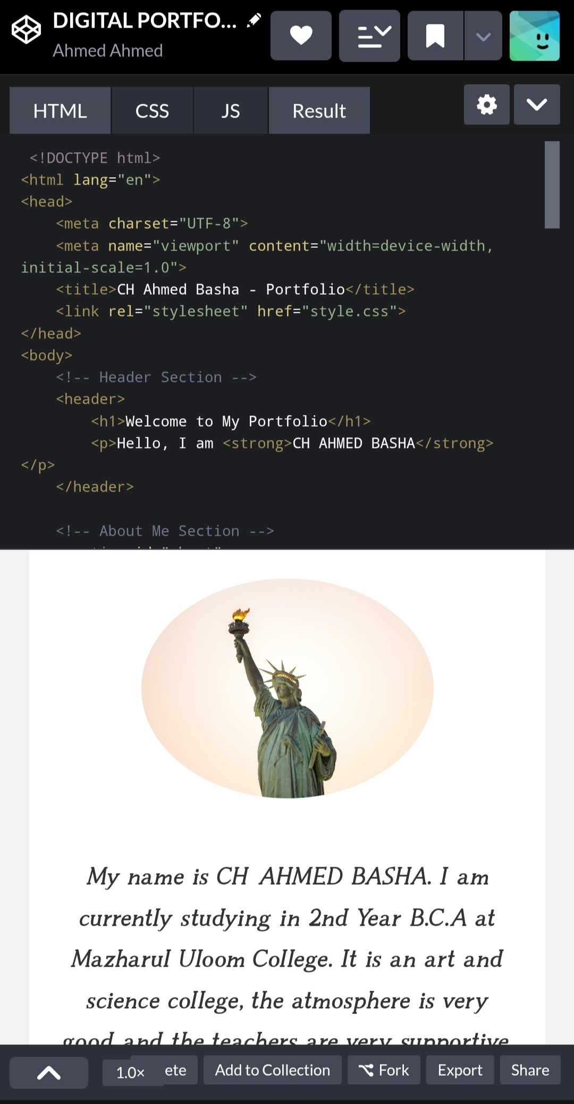

RESULTS AND SCREENSHOTS
Successfully designed and hosted digital portfolio
Accessible across devices
Screenshots of the homepage, projects section, and contact form
3/21/2024 Annual Review
10

Slide 11
CONCLUSION
The digital portfolio provides an effective way to highlight skills and achievements. It helps students and professionals showcase their profiles in an interactive, modern, and professional manner, making them stand out in academic and career opportunities. +
11

